Slide 1
Course Management System - SEPM A2
Alex Huang, Ang Wee Jueh, Edward Tuhawaire, So Yeun Jeon

Slide 2
Project Description
To create a Java-based course management system
Console-based entry and output application
Ability to enrol students to one of 5 different courses at the institute
Being able to handle varying running costs and fees for different courses
Limiting enrolments for courses
Offering discounts to repeat customers

Slide 3
Sprint Methodology
Sprint kickoff to clarify team member responsibilities
In person scrum meetings held weekly during tutorials
Online communication held every 2-3 days or as time permits
Updating team on progress for product backlog items to be done
Discussing any difficulties that each team member is having
Sprint retrospective to review any improvements and issues

Slide 4
Sprint 1 - Project Initialisation
Length: 10 days
Story Points: 30
Github project initialisation
Console Menu & Navigation
Class Diagrams
File Structure
Sprint Retrospective

Slide 5
Sprint 1 - Proof

Slide 6
Sprint 1 Outcomes
Completed in the allotted time with no issues
Smooth initialisation of project

Slide 7
Sprint 2 - Implementing Additional Functionality
Spring Length: 10 Days
Story Points: 26
Enrolment of students
Error Checking of input
Serialisation of data
Student details display
Enrolment discount feature
Sprint Retrospective

Slide 8
Sprint 2 - Proof

Slide 9
Sprint 2 Outcomes
Some difficulties regarding the more complex parts of coding
Enrolment feature faced some difficulties regarding discounts
Assignment deadlines from other subjects slowing down progress

Slide 10
Sprint 3 - Final Product
Sprint Length: 10 Days
Story Points: 26
Student withdraw function
Updating course fees
Testing & Bug Fixing
User & Technical Documentation
Sprint Retrospective & Submission

Slide 11
Sprint 3 - Proof

Slide 12
Sprint 3 Outcomes
Student withdraw feature faced issues with properly reverting financial costs and fees
Integration of all features took time to debug

Slide 13
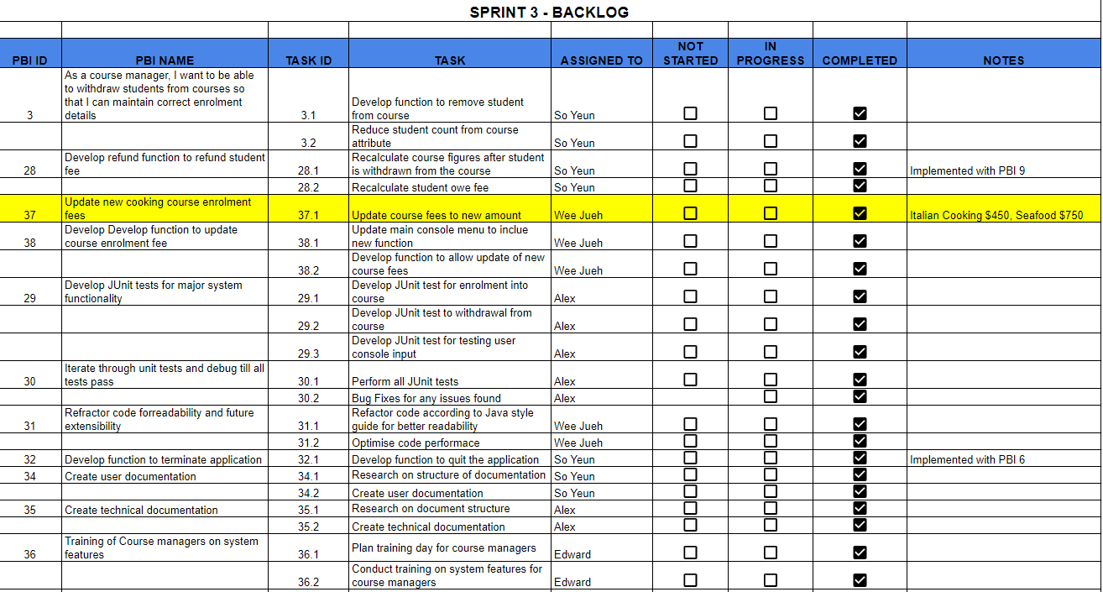
PBI Change
Product owner ordered a change to requirements mid-way through the project
Excerpt from Sprint 3 Product Backlog

